Slide 1

 | BMS INSTITUTE OF TECHNOLOGY & MANAGEMENT, YELAHANKA, BANGALORE. Department of Artificial Intelligence and Machine Learning
DataCleaner for Non-Image Datasets
PBL REVIEW PHASE -1 (13-05-2023)
ARAVIND SURESH
M S KAUSHIK
MANISH A S
SANDEEP AROCKIA SAMRAJ X
UNDER THE GUIDANCE OF:
Dr. Rajesh I S
Assistant Professor, AI&ML
BMSIT&M
2020-21

Slide 2
CONTENT
Introduction
Problem Statement
Objective
Literature Survey
Limitations of Existing Systems
Research Gap and Research Challenges
Proposed Methodology
Subject Mapping
References

Slide 3
INTRODUCTION
Data cleaning is part of data preprocessing.It deals with detecting and removing errors and inconsistencies from data in order to improve quality of data.
In recent years, data science, artificial intelligence and machine learning domains are the new trend in IT industries. These domains are mainly dependent on datasets and these datasets must be cleaned in order to arrive at accurate results.

Slide 4
INTRODUCTION(CONTD)
The project deals with cleaning of data by removing the unnecessary features in the dataset and filling the missing values. It also has the option to provide the metrics of the dataset for a particular machine learning algorithm model.

Slide 5
PROBLEM STATEMENT
Cleaning a dataset is time consuming and only small datasets can be cleaned manually.

Slide 6
OBJECTIVE
To reduce the time to clean the dataset.
Also to provide a general idea on how good the dataset is for a particular machine learning algorithm.
To improve the quality of the dataset.

Slide 7
LITERATURE SURVEY
SL No. | Paper | Work Carried out | Limitations
1. | Jesmeen, M.Z.H., Hossen, J “A survey on cleaning dirty data using machine learning paradigm for big data analytics.” [1] | An overview is initiated to identify the potential of data cleaning in big data analytics in the process of gathering, arranging and processing information. A comparison of commercialized tools is presented by obtaining comments from different customers. | Scalability User Engagement Manual
2. | Neutatz. F, Chen. B “From Cleaning before ML to Cleaning for ML” [2] | The data is prepared by canonicalizing the user ids, extracting product information from the browsed pages, and ensuring that the expected attributes appear in each data record. Separate data science teams develop two models: the first estimates the likelihood that a given user will leave the service (churn), and the second estimates a user’s preference for different products (affinity). | Unstructured data Population-level Errors Model entanglement

Slide 8
3. | Ga Young Lee, Lubna Alzamil “A Survey on Data Cleaning Methods for Improved Machine Learning Model Performance”[3] | Survey paper presents several approaches to data cleaning developed by reputable researchers and developers in the database management systems field to solve the challenge with data cleaning. Various data cleaning techniques are analyzed and compared, a general trend observed from the literature review is a transition toward more scalable and efficient frameworks that aims to reduce the human overhead cost in the development of more accurate and representative data instances | Lack of Optimizer Tradeoff Between Efficiency and Coverage Limited Generalizability
4. | Mohammad Mahdavi , Felix Neutatz “Towards Automated Data Cleaning Workflows” [4] | For unknown datasets, it is unrealistic to know the data quality problems upfront and to formulate all necessary quality constraints in one shot. Pragmatically, the user solves data quality problems by implementing an iterative cleaning process. This incremental approach poses the challenge of identifying the right sequence of cleaning routines and their configurations. | Scalability Lack of Optimizer Model entanglement

Slide 9
5. | David Camilo Corrales, Juan Carlos Corrales “How to Address the Data Quality Issues in Regression Models: A Guided Process for Data Cleaning” [5] | DC-RM provides support to methodologies from data mining and machine learning. For instance, in Knowledge Discovery in Databases, DC-RM can support the Preprocessing and Data Cleaning, Data Reduction, and Projection phases. In Cross Industry Standard Process for Data Mining, DC-RM gives support to Verify Data Quality and Clean Data steps. and, in Data Science Process into the Clean Data phase | Outliers Detection Density-Based Spatial Clustering

Slide 10
LIMITATIONS OF EXISTING SYSTEM
It consumes more time.
Doesn’t remove the unnecessary features.
Manually cleaning the values of datasets may lead to removal of necessary data.

Slide 11
RESEARCH GAP AND RESEARCH CHALLENGES
Automatic cleaning of dataset.
Using different algorithms.

Slide 12
PROPOSED METHODOLOGY
The frontend of the website is created using ReactJS and for backend Python (Flask) is used. Then to fix the missing values, a decision will be made whether to remove the entire row of the missing field or to fill the values using mean, median or interpolation methods. Then to convert textual values to numerical we use the one Hot Encoding method. To select the required features we use Univariate Selection which is used to select those features that have the strongest relationship with the output variable.Finally the cleaned dataset will be available to download.

Slide 13
PROPOSED METHODOLOGY(CONTD)
If the metrics are required by the user, then if the user must select the algorithm name then a model will be created and tested for its accuracy, precision, recall, etc and display the metrics along with the cleaned data.
The flow diagram of the methodology is show below.

Slide 14
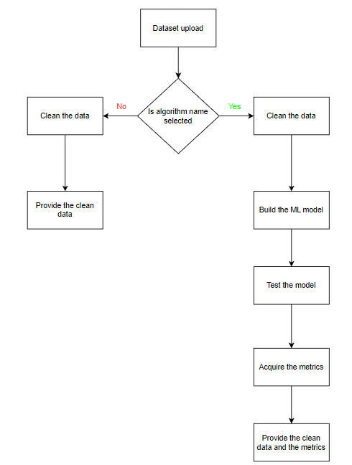
PROPOSED METHODOLOGY(CONTD)
Fig. 1

Slide 15
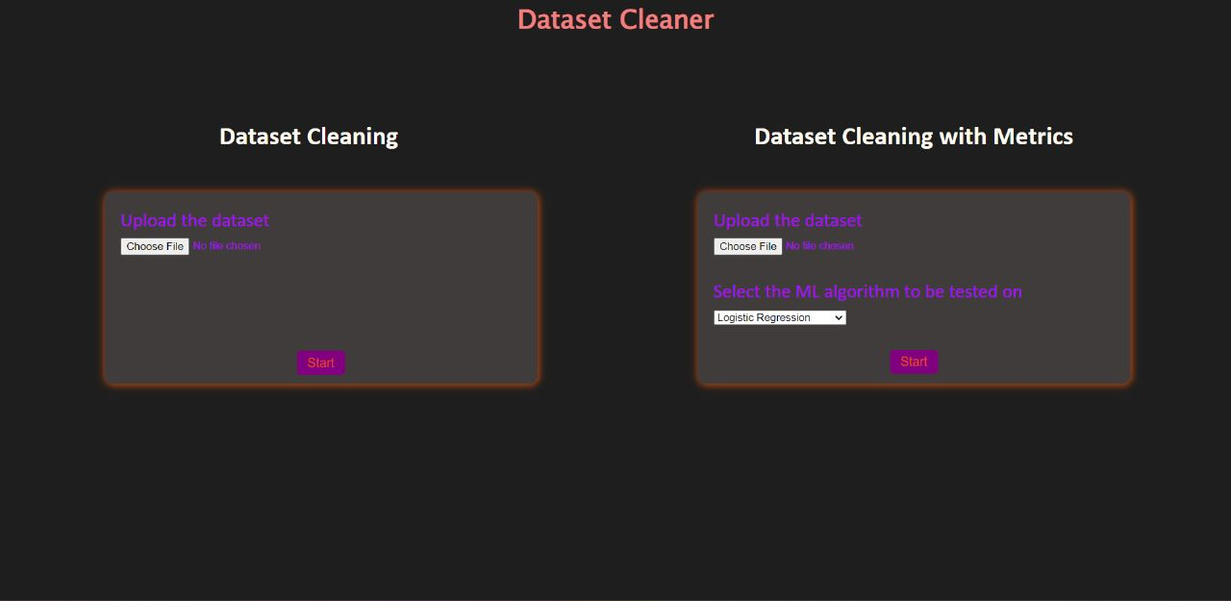
SNIPPET OF THE WEBSITE

Slide 16
SUBJECT MAPPING
Machine Learning (18AI61) - We use sklearn methods to filter the required features and machine learning algorithms to build a model and calculate the metrics.

Slide 17
REFERENCES
1.Jesmeen, M.Z.H., Hossen, J., Sayeed, S., Ho, C.K., Tawsif, K., Rahman, A. and Arif, E., 2018. A survey on cleaning dirty data using machine learning paradigm for big data analytics. Indonesian Journal of Electrical Engineering and Computer Science, 10(3), pp.1234-1243.
2.Neutatz, F., Chen, B., Abedjan, Z. and Wu, E., 2021. From Cleaning before ML to Cleaning for ML. IEEE Data Eng. Bull., 44(1), pp.24-41.
3.Ga Young Lee, Lubna Alzamil, Bakhtiyar Doskenov, Arash Termehchy
Cite As: arXiv:2109.07127 [cs.DB]
4.Mahdavi, M., Neutatz, F., Visengeriyeva, L. and Abedjan, Z., 2019. Towards automated data cleaning workflows. Machine Learning, 15, p.16.
5.Corrales, D.C., Corrales, J.C. and Ledezma, A., 2018. How to address the data quality issues in regression models: a guided process for data cleaning. Symmetry, 10(4), p.99.

Slide 18


